Slide 1
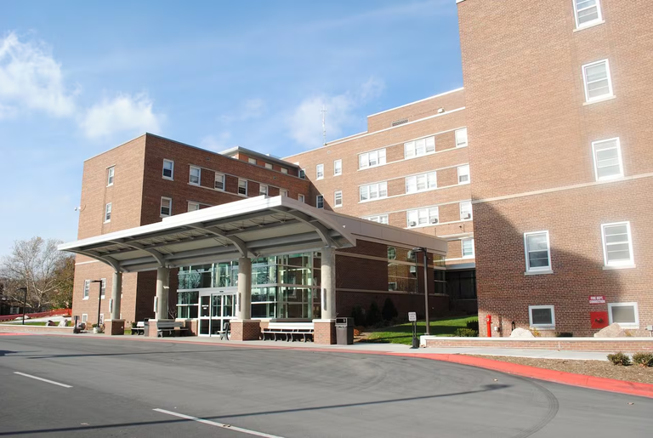
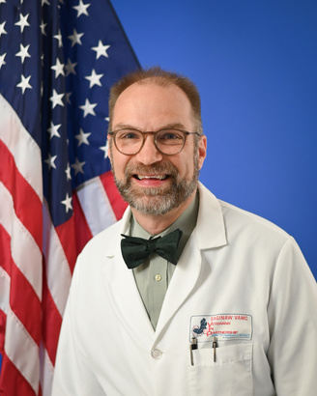
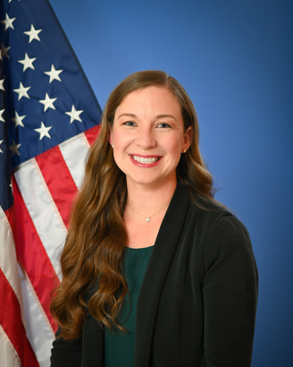



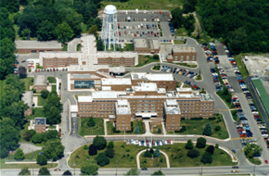

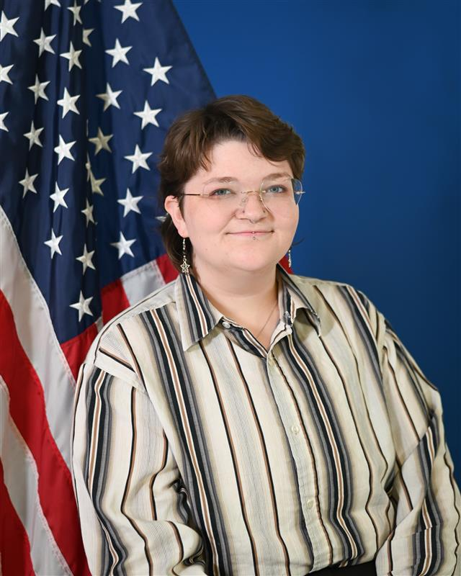
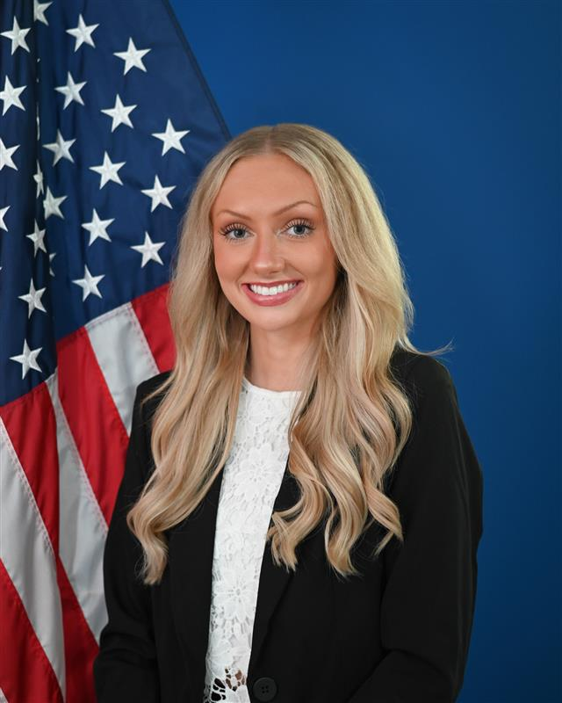
Saginaw VA Medical Center
  Established in 1950
  More than 35,000 Veterans are served throughout central and northern lower peninsula of Michigan
  One medical center in Saginaw, MI with 81 Community Living Center beds, 12 Palliative Care beds, 6 Patient-Aligned Care Teams, and various specialty clinics
  9 Community-Based Outpatient Clinics (CBOCs) and 1 Healthcare Center throughout MI
For More Information, Please Contact:
Jim Lile, PharmD, FASHP, BCGP
Residency Program Director
(989)497-2500 ext. 11740
james.lile@va.gov
Iva Keene, PharmD, CDCES
Residency Program Coordinator
(989)497-2500 ext. 11742
iva.keene@va.gov
Affiliations:
Aleda E. Lutz Veterans Affairs Medical Center
This residency site agrees that no person at this site will solicit, accept, or use any ranking-related information from any residency
applicant.
PGY-1 Pharmacy
Residency Program
Current PGY-1 Pharmacy Residents:
1500 Weiss Street Saginaw, MI
Hannah Odekirk, PharmD
(989)497-2500 ext. 11741
Hannah.odekirk@va.gov
Rachel Hahn, PharmD
(989)497-2500 ext. 11707
Rachel.hahn2@va.gov
Purpose Statement:
The Aleda E. Lutz VA Medical Center PGY1 pharmacy residency builds on the Doctor of Pharmacy (Pharm.D.) education and outcomes to contribute to the development of clinical pharmacists responsible for medication-related care of patients with a wide range of conditions, eligible for board certification, and eligible for postgraduate year two (PGY2) pharmacy residency training.
“To fulfill President Lincoln’s promise to care for those who have served in our nation’s military and for their families, caregivers, and survivors.”
Website:
https://www.va.gov/saginaw-health-care/work-with-us/internships-and-fellowships/pharmacy-residency/

Slide 2
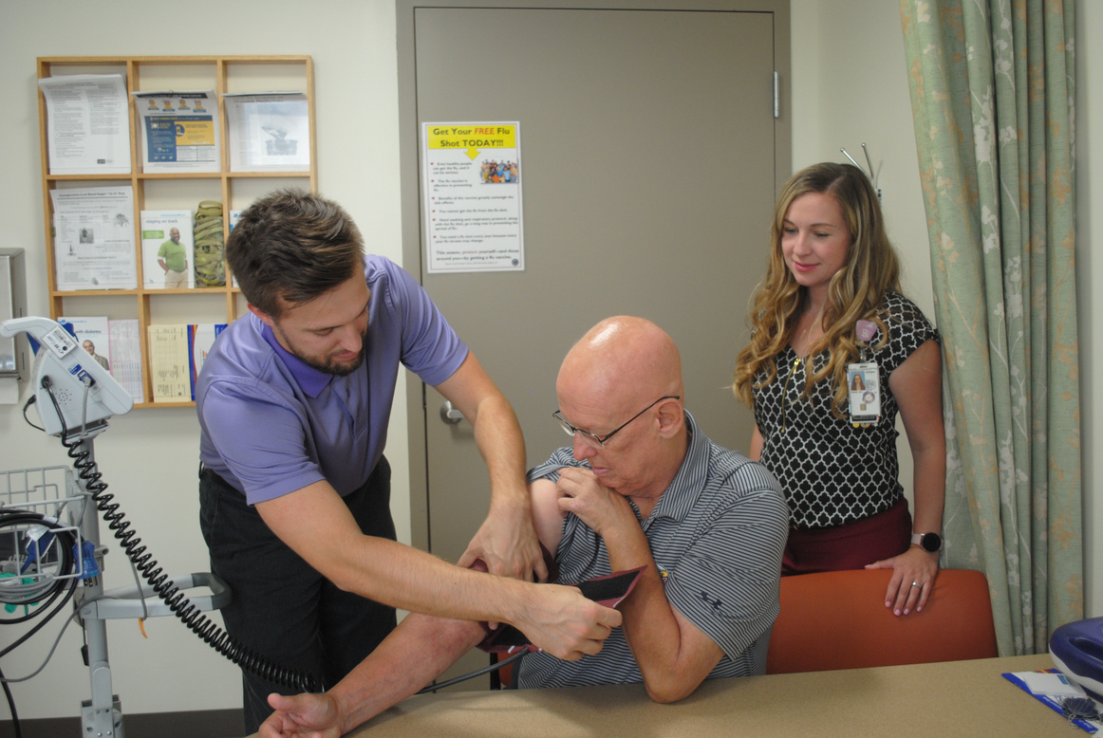
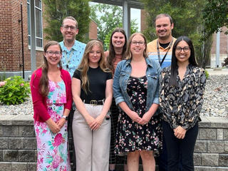
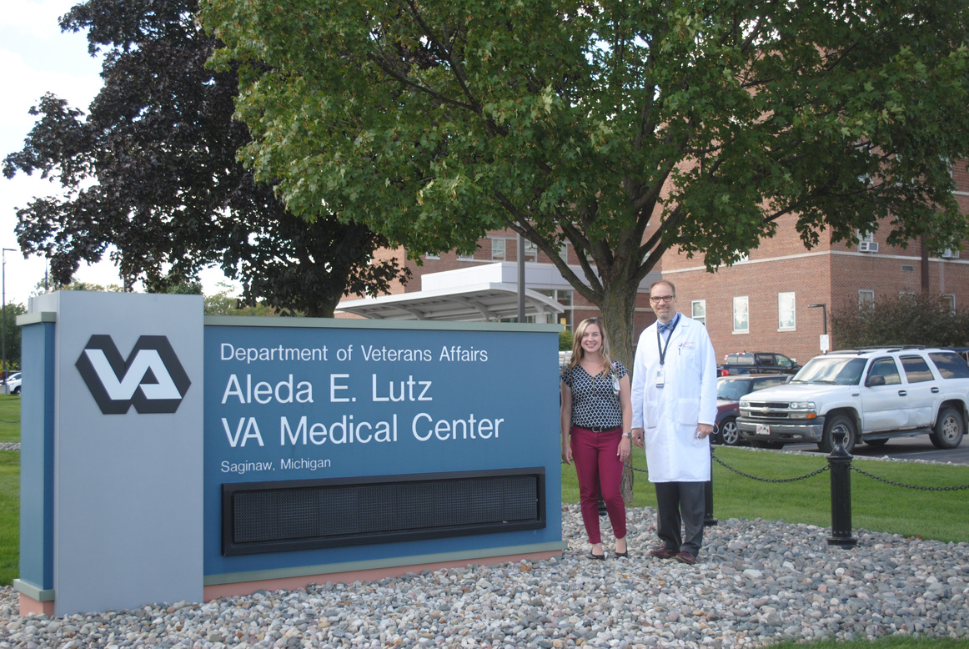
Program Structure
Requirements:
· Doctor of Pharmacy Degree from ACPE-Accredited School of Pharmacy
· Eligible for Pharmacy Licensure in the U.S. or District of Columbia
· USA Citizen
8am-4:30pm Monday-Friday
No weekends or holidays
Required Rotations
Ambulatory Care (12 weeks)
Pharmacy Management (1 week)
Pharmacy Informatics (1 week)
Pain Resource Team (4 weeks)*
Outpatient Mental Health (4 weeks)*
Application Materials:
Benefits
***All documents must be
submitted online through
PhORCAS***
· Academic Transcripts
· Curriculum Vitae
· Three professional recommendations completed in PhORCAS
· Stipend: $49,194 (2026-2027)
· 13 days annual leave (accrued)
· 13 days sick leave (accrued)
· 11 paid Federal holidays
· Administrative leave as approved by local policy
· Federal Employees Health Benefits (FEHB) www.opm.gov/insure/health
· Federal Employees’ Group Life Insurance (FEGLI) www.opm.gov/insure/life
Longitudinal Requirements
Pharmacy Informatics & Management
Anticoagulation Clinic (2 days/rotation)
GEM Clinic Monday PM
Professional Development
Residency Project
A Few Past Residents:
Elective Rotations
Academia (VA Teaching Certificate)
Academia
Antimicrobial Stewardship/Geriatric Evaluation and Management (GEM)
Health Promotion Disease Prevention
Ambulatory Care (PACT 3, 5 weeks)
Outpatient Mental Health 2 & 3
Rural Health 1, 2, & 3
Anticoagulation Clinic
Women’s Health
Academic Detailing
Community Living Center (CLC)
Application Deadline: January 8, 2027
Interview Notification: January 15, 2027

